Slide 1


How to power
COBIFY
Executive Report
Sebastian Bobeth
Ironhack Tech Challenge (Career Week)

Slide 2
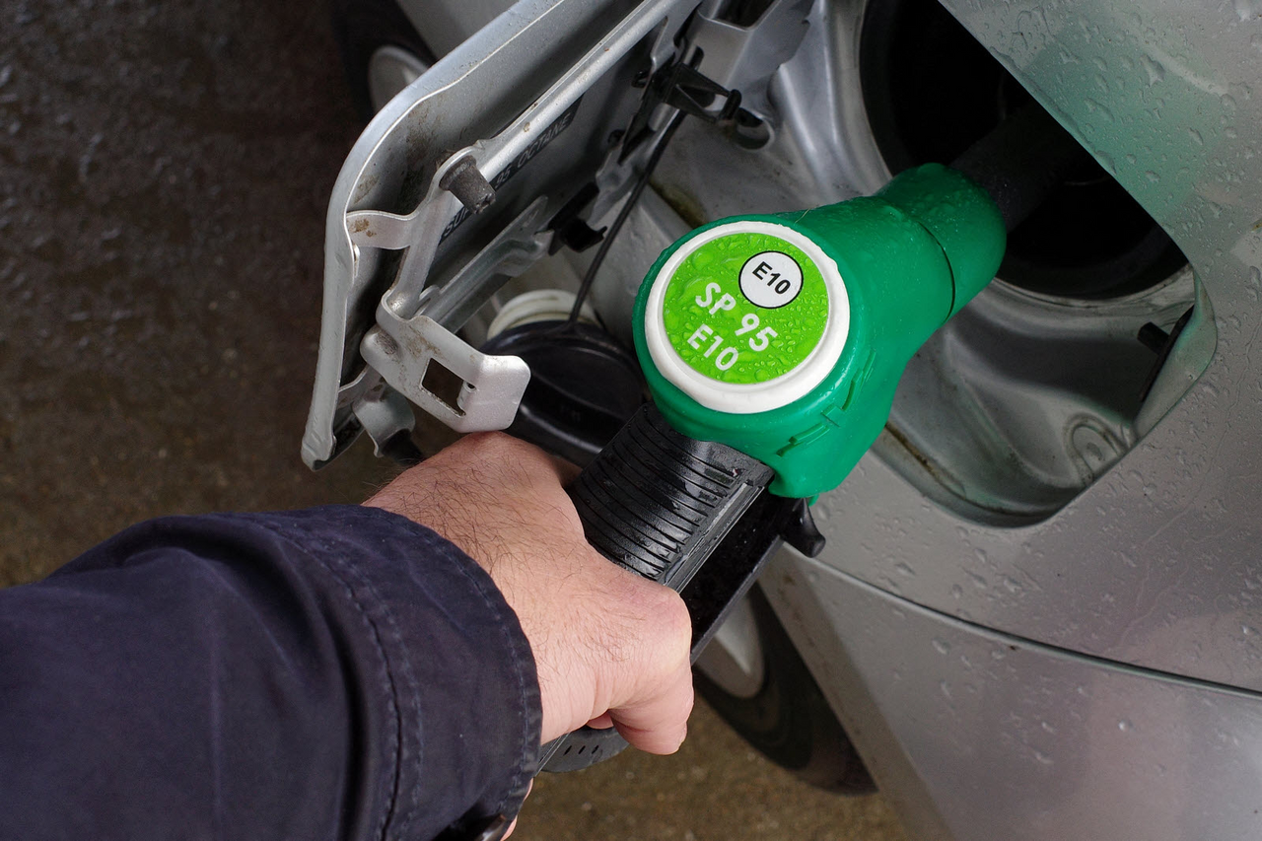
Your Data Question
Shall Cobify switch the fuel type of cars from SP98 to E10?
Prices:
SP98: 1,46€/l
E10: 1,38€/l

Slide 3
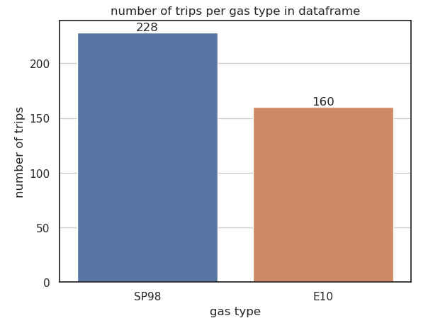
Your Data
You collected data on several hundred trips with gas types SP98 and E10.
Variables included:
Distance (km)
Average speed (km/h)
Consume (l / 100 km)
Temperatue (inside / outside)
Weather (sunny / rainy, snowy)
AC usage

Slide 4
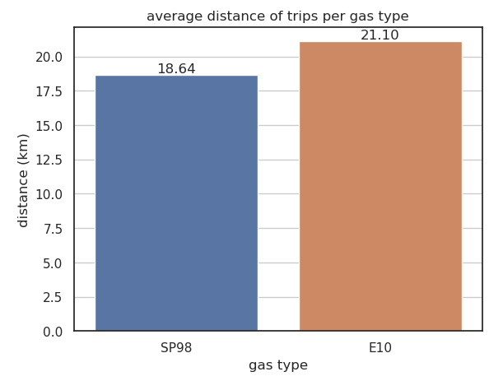
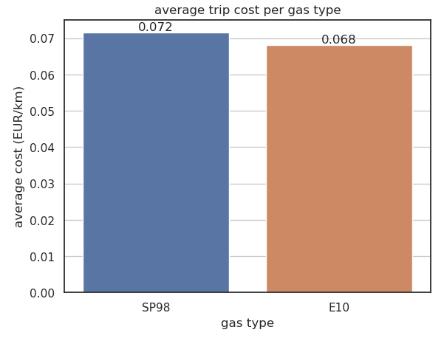
Exploring the fuel types
The average trip length was a bit higher for trips with E10, while the relative trip costs were a tiny bit lower.

Slide 5
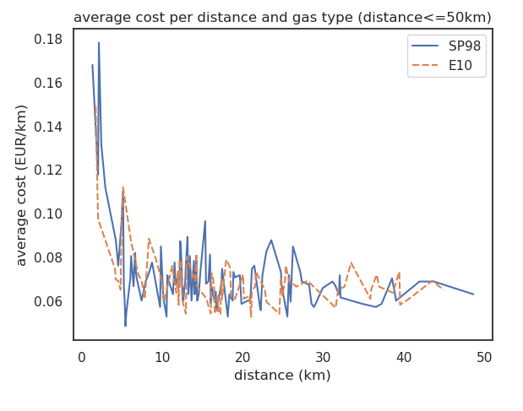
Exploring the fuel types
But does this lead to significant savings?
The picture is not quite clear yet.

Slide 6
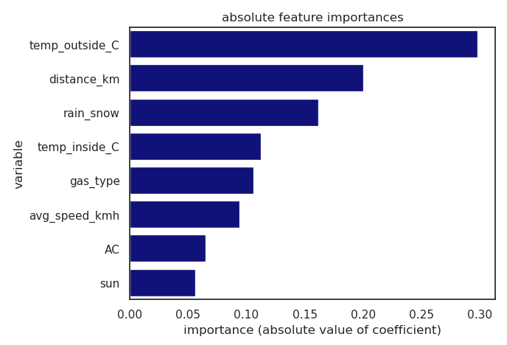

Predicting relative trip costs with a machine learning (OLS) model
Gas type is only the fifth most important feature for predicting the relative costs of a trip
... but it still makes a significant difference!

Slide 7
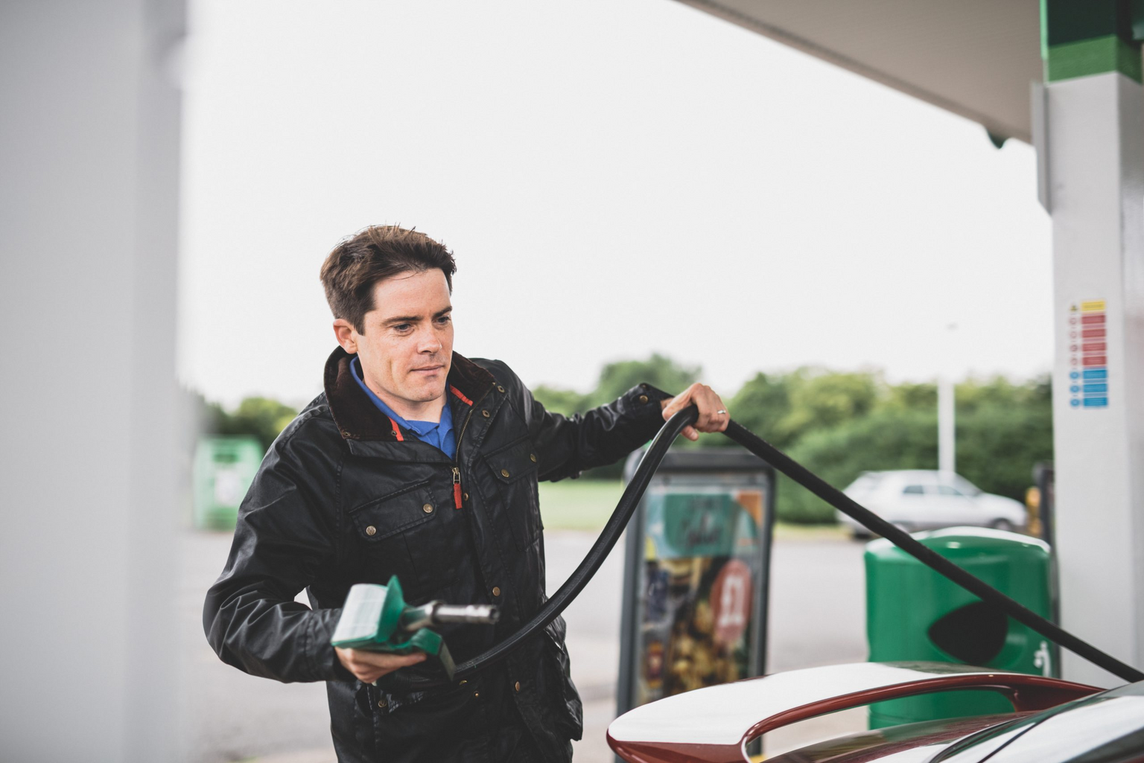
Recommendations
If you want to save some money, switch to E10!
...However, to perfect our model and validate the recommendations, we need additional resources.

Slide 8
Thank you for your attention!
...and happy holidays :)

